Slide 1
Introduction to Software Engineering and SaaS

Slide 2
What Makes a Great Software Engineer?
Always improving
Passionate
Technically open-minded
Data-driven
Elegant solutions
Creative thinking when faced with limitations of current solutions
Anticipates technical needs based on prior experience
Personal Characteristics
Technical Skills
Knows people & organization
Updates mental models when learn new skills/facts/context
Consider situation at multiple levels when making judgments
Can reason about complex & intertwining ideas
Helps others understand by tailoring explanations to them
Creates shared success possibly via personal compromises
Creates “safe haven” where others can learn from mistakes
Gives honest feedback
Decision Making
Team Skills

Slide 3
Online Resources
http://www.saasbook.info/students
Online "get started" tutorials on ruby in case want to get feet wet before Ruby lectures
Pointers to online HTML/CSS tutorials in in case want to get feet wet before Rails material
Tutorials on other tools (GitHub, etc.)

Slide 4
Which aspect of the software lifecycle consumes the most resources?
Design
Development
Testing
Maintenance
Notes:
Sales/Marketing & Support?

Slide 5
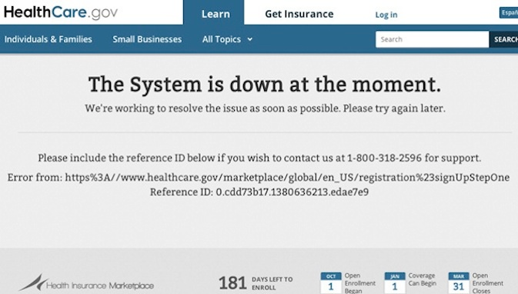
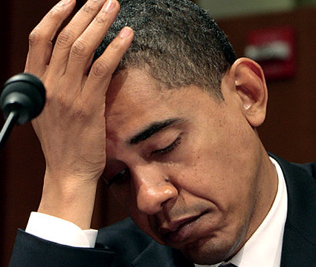
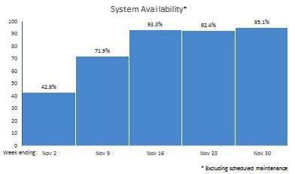
Poor President Obama…
95.1%
42.9%
“HealthCare.gov Progress & Performance Report”, CMS.gov, 12/1/13

Slide 6
How can you avoid infamy?
Lessons from 60 years of SW development
This class will review many approaches in lecture, listing pros and cons
Understand that software engineering is more than just programming

Slide 7
Plan-and-Document processes: Waterfall vs. Spiral vs. RUP
Engineering Long Lasting Software §1.8, §10.7
Notes:
Waterfall & Spiral
Versus RUP - Iterative

Slide 8
How to Avoid SW Infamy?
Can't we make building software as predictable in schedule and cost and quality as building a bridge?
If so, what kind of development process to make it predictable?

Slide 9
Software Engineering
Bring engineering discipline to SW
Term coined ~ 20 years after 1st computer
Find SW development methods as predictable in quality, cost, and time as civil engineering
“Plan-and-Document”
Before coding, project manager makes plan
Write detailed documentation all phases of plan
Progress measured against the plan
Changes to project must be reflected in documentation and possibly to plan

Slide 10

1st Development Process: Waterfall (1970)
5 phases of Waterfall “lifecycle”
Requirements analysis & specification
Architectural design
Implementation & Integration
Verification / Testing
Operation & Maintenance
Complete one phase before start next one
Why? Earlier catch bug, cheaper it is
Extensive documentation/phase for new people
(Photo by Carola Lauber of SD&M www.sdm.de. Used by permission under CC-BY-SA-3.0.)
Notes:
Often there are different people participating in the phases

Slide 11
How well does Waterfall work?
And the users exclaimed with a laugh and a taunt: “It’s just what we asked for, but not what we want.”
Anonymous
Often when customer sees it, wants changes to SW product
Notes:
Flaws:
The assumption that it is nearly impossible redesign or change and application is flawed (or at least it does not have to be true)… “It’s like building a house.”
The cost of flawed assumptions early in the project are immense because the can’t be proven to be flawed until much much later… how do you demonstrate that a “design” is complete or accurate
Individuals can claim success even if the project fails
Be the time it’s delivered, it is no longer what the business or customer wants

Slide 12
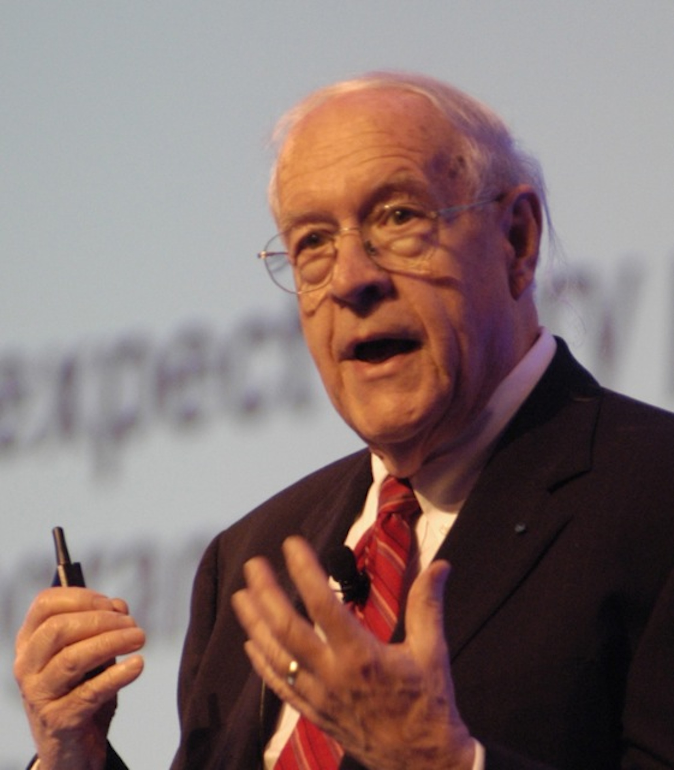
How well does Waterfall work?
“Plan to throw one [implementation] away; you will, anyhow.”
Fred Brooks, Jr. (1999 Turing Award winner)
Often after build first one, developers learn right way they should have built it
(Photo by Carola Lauber of SD&M www.sdm.de. Used by permission under CC-BY-SA-3.0.)
Notes:
May apply to your project
Downside to waterfall?

Slide 13
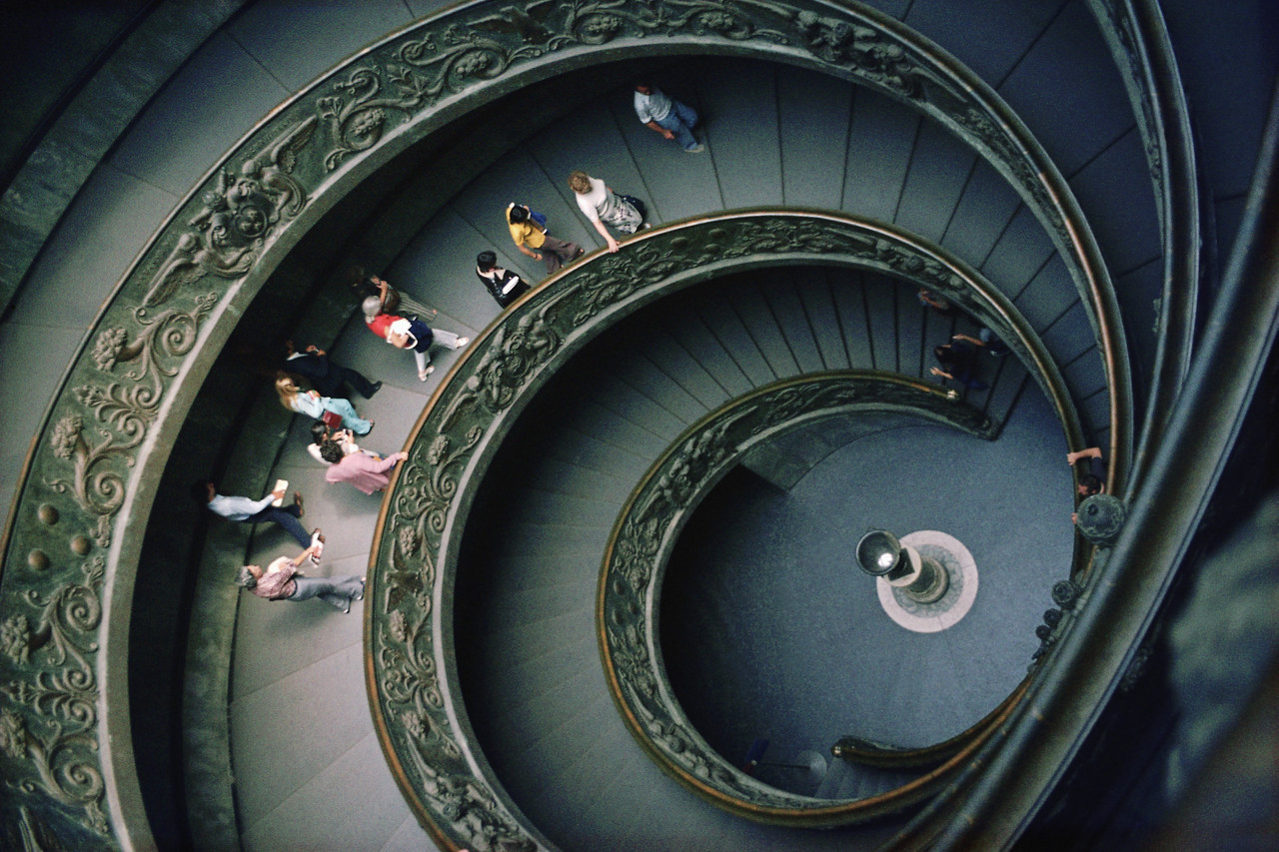
Spiral Lifecycle (1986)
Combine Plan-and-Document with prototypes
Rather than plan and document all requirements first…
develop plan and requirement documents across each iteration of prototype as needed and evolve with the project
Notes:
Add Prototypes to Waterfall
Good stepping stone to RUP

Slide 14
Spiral Lifecycle
(Figure 1.4, Engineering Long Lasting Software by Armando Fox and David Patterson, 2nd Beta edition, 2013.)

Slide 15
Spiral - Good and Bad
The Good
The Bad
Iterations involve the customer before the product is completed
Reduces chances of misunderstandings
Risk management part of lifecycle
Project monitoring easy
Schedule & cost more realistic over time
Iterations 6 to 24 months long
time for customers to change their minds!
Lots of documentation per iteration
Lots of rules to follow, hard for whole project
Cost of process is high
Hard to meet budget and schedule targets
Notes:
Prototypes… prototypes are a good addition to Waterfall

Slide 16
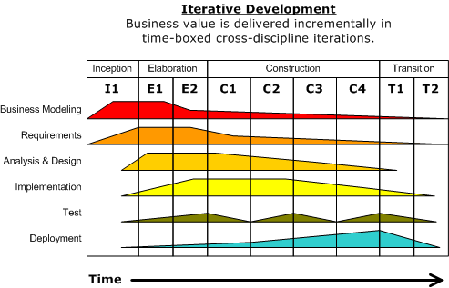
Rational Unified Process (RUP) Lifecycle (2003)
Figure 1.5, Engineering Long Lasting Software by Armando Fox and David Patterson, 2nd Beta edition, 2013.
Notes:
Iterative

Slide 17
RUP Phases
4 Phases (can iterate)
Inception: business case, set schedule and budget, risk assessment
Elaboration: use cases, SW architecture, prototype
Construction: codes and tests the product, 1st release.
Transition: move to real environment, get customer acceptance

Slide 18
RUP - Good and Bad
the good
The Bad
Business practices tied to development process
Lots of tools from Rational (now IBM)
Tools support gradual improvement of project
Tools are expensive (not open source) … OpenUP is an open source implementation of RUP [link]
So many options to tailor RUP to a company, so not use all the tools
Only good for medium to large-scale projects
Manager’s call size of iterations to make manageable
Notes:
More beneficial or maybe necessary in:
Fixed-bid outsource type project
Multi-sponsored projects
Large projects can be very difficult with Scrum

Slide 19

Plan and Document (P&D) Project Manager
P&D depends on Project Managers
Write contract to win the project
Recruit development team
Evaluate software engineers performance, which sets salary
Estimate costs, maintain schedule, evaluate risks & overcomes them
Document project management plan
Gets credit for success or blamed if projects are late or over budget
Notes:
Waterfall “can’t” work
Iterative/RUP/OpenUP can work

Slide 20
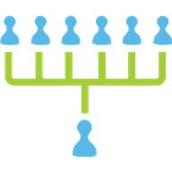
P&D Team Size
“Adding manpower to a late software project makes it later.”
Fred Brooks, Jr., The Mythical Man-Month
It takes time for new people to learn project
Communication time grows with size, leaving less time for work
Groups 4 to 9 people, but hierarchically composed for larger projects
Notes:
Software development activities scale terribly… will take a small talented/dedicated team over a large average team every day!

Slide 21
Question: Which statement is FALSE about Waterfall, Spiral, and Rational Unified Process lifecycles?
All rely on careful planning and measure progress against the plan
All rely on thorough documentation
All rely on a manager to be in charge of the project
All use iteration and prototypes
Notes:
Αδδινγ ιτερατιονσ ανδ προτοτψπεσ το Ωατερφαλλ (ωηιχη ιτ βασιχαλλψ βεχομεσ Σπιραλ) ισ τηε φιρστ τηινγ το “χηεατ” ον ιφ ψου αρε ον α Ωατερφαλλ προϕεχτ/τεαμ.

Slide 22
Development processes: Agile
(Engineering Long Lasting Software §1.9)
David Patterson

Slide 23
Agile Manifesto, 2001
“We are uncovering better ways of developing SW by doing it and helping others do it. Through this work we have come to value
Individuals and interactions over processes & tools
Working software over comprehensive documentation
Customer collaboration over contract negotiation
Responding to change over following a plan
That is, while there is value in the items on the right, we value the items on the left more.”

Slide 24
Agile Then and Now
Controversial in 2001
“… yet another attempt to undermine the discipline of software engineering… nothing more than an attempt to legitimize hacker behavior.” Steven Ratkin, “Manifesto Elicits Cynicism,” IEEE Computer, 2001
Accepted in 2013
2012 study of 66 projects found majority using Agile, even for distributed teams
Notes:
Agile Team are intended to be co-located… it is hard for team members to work remotely. Easier for full teams to be co-located and have teams separate geographically.

Slide 25
Agile
Philosophies: Agile & Lean
Processes/Methodologies: Scrum, Kanban, XP, and Scaled Agile
Process Frameworks: CMMI & ISO
Notes:
Agile Team are intended to be co-located… it is hard for team members to work remotely. Easier for full teams to be co-located and have teams separate geographically.
https://realtimeboard.com/blog/choose-between-agile-lean-scrum-kanban/#.WmdEcainFZc

Slide 26
Scrum
Sprints
Backlogs
User Stories
Sprint Planning
Daily Standups
Continuous Improvement
Retrospectives
…
Notes:
Agile Team are intended to be co-located… it is hard for team members to work remotely. Easier for full teams to be co-located and have teams separate geographically.
https://realtimeboard.com/blog/choose-between-agile-lean-scrum-kanban/#.WmdEcainFZc

Slide 27
Extreme Programming (XP)
If short iterations are good, make them as short as possible (weeks vs. years)
If simplicity is good, always do the simplest thing that could possibly work
If testing is good, test all the time. Write the test code before you write the code to test.
If code reviews are good, review code continuously, by programming in pairs, taking turns looking over each other's shoulders.
Notes:
XP is really the Engineering Practices of Agile
It would be entirely appropriate to be a Scrum team utilizing XP practices

Slide 28
Extreme Programming (XP)
Practices:
Test driven development
Small releases
Continuous integration
Coding standards
Pair programming
Notes:
XP is really the Engineering Practices of Agile
It would be entirely appropriate to be a Scrum team utilizing XP practices

Slide 29
Agile lifecycle
Embraces change as a fact of life: continuous improvement vs. phases
Developers continuously refine working but incomplete prototype until customers happy, with customer feedback on each Iteration
every ~1 to 2 weeks
Agile emphasizes
Test-Driven Development (TDD) to reduce mistakes
User Stories to validate customer requirements
Velocity to measure progress

Slide 30
Question: Which statement is TRUE?
A big difference between Agile and P&D is that Agile does not use requirements
A big difference between Agile and P&D is measuring progress against a plan
You can build SaaS apps using Agile, but not with Plan-and-Document
A big difference between Agile and P&D is building prototypes and interacting with customers during the process
Notes:
VertLeftWhiteCheck1
While Agile does not develop extensive requirements documents as does Waterfall, the interactions with customers lead to the creation of requirements as user stories, as we shall see in Chapter 7
Βεχκ: Παρτ οφ χοπινγ ωιτη χηανγε ισ μακινγ χηανγε ατ αρχηιτεχτυραλ λεϖελ –
Both build working but incomplete prototypes that the customer helps evaluate. The difference is that customers are involved every two weeks in Agile versus up to two years in with Spiral.
The answer is measuring progress against a plan

Slide 31
Fallacies and Pitfalls, and Chapter 1 Summary
Engineering Long Lasting Software §§1.12, 1.13
David Patterson

Slide 32
Fallacies and Pitfalls
Fallacy: The Agile lifecycle is best for software development
Good match for some SW, especially SaaS
But not for NASA, code subject to regulations
Per topic, will practice Agile way to learn but will also see Plan and Document perspective
Note: you will see new lifecycles in response to new opportunities in your career, so expect to learn new ones
Notes:
Fallacy – sounds true, but false
Pitfall – know it might happen, but it happens anyways
We will be focusing on Agile, comparing it to Iterative, and learning how to surviveWaterfall
When we talk about “Agile”, let’s be specific. For example, Scrum and XP would not be a very good fit for a team of 400 people. The Scaled Agile Framework might be.

Slide 33
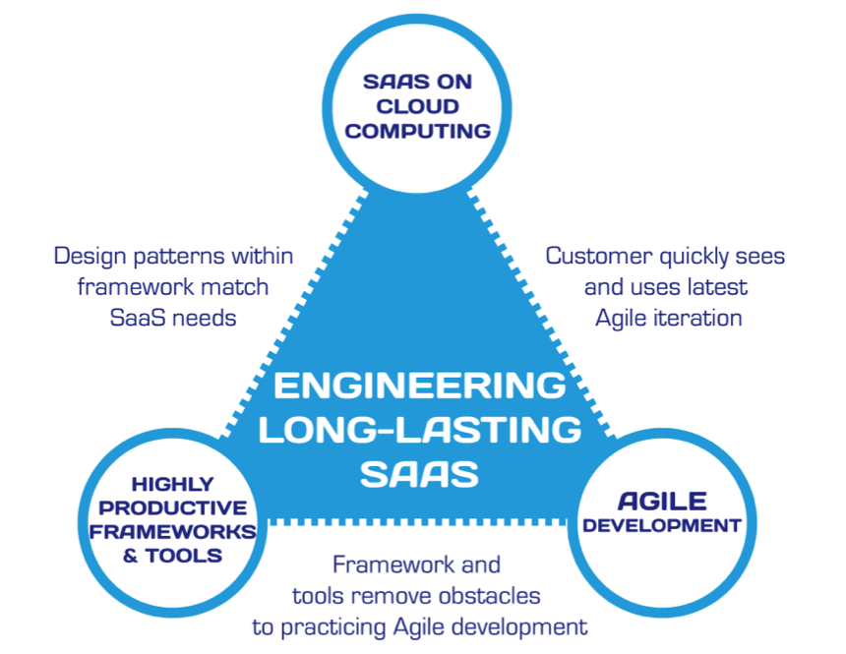
Summary: Engineering SW is More Than Programming
(Figure 1.7, Engineering Long Lasting Software by Armando Fox and David Patterson, Beta edition, 2012.)

Slide 34
Software as a Service (SaaS) and Service-Oriented Architecture (SOA)
Engineering Software as a Service §1.2-1.3
David Patterson

Slide 35




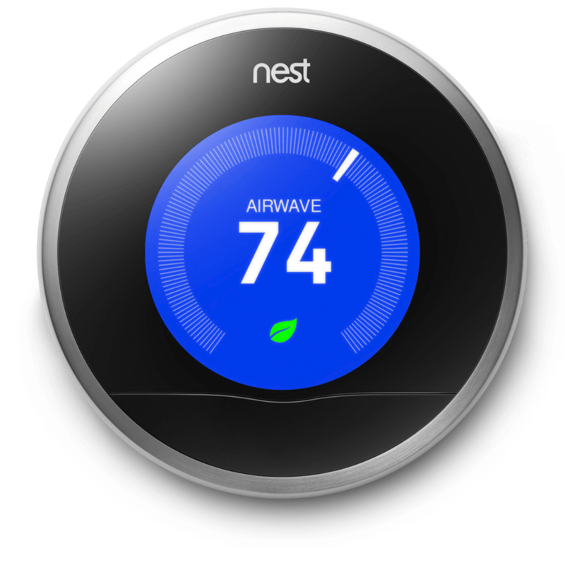

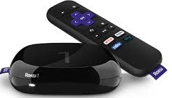
What do they have in common?

Slide 36
Native Applications
client-specific binary, frequent upgrades
Must work w/many versions of HW, OS, Libraries, …
Hard to maintain
Extensive compatibility testing per release
Alternative: server-centric app, thin client
Search, email, commerce, social nets, video…
Now also productivity (Google Docs/Office 365), finance (TurboTax Online), IDEs (Codenvy)…

Slide 37
Why is SaaS better/easier than Native Applciations?
No install worries about HW capability, OS
Data stored safely, persistently on servers
Easy for groups to interact with same data
If data is large or changed frequently, simpler to keep 1 copy at central site
1 copy of SW and single HW/OS environment
no compatibility hassles for developers
beta test new features on 1% of users
simplifies upgrades for developers and no user upgrade requests
Notes:
Fabulous way of developing if customers will accept.

Slide 38
Smartphone Native
Pros
Cons
Use HW features unavailable in HTML5
May be faster…or not
Many just HTML5 apps in native "container"
Your brand is on user’s home screen
Though can get this with bookmarks too
Harder to maintain
Upgrades now once again user's problem

Slide 39
Bookstore: Silo
Internal subsystems can share data directly
Review access user profile
All subsystems inside single API
(Figure 1.2, Engineering Software as a Service by Armando Fox and David Patterson, 2nd Beta edition, 2013.)

Slide 40
Bookstore: SOA
Subsystems independent, as if in separate datacenters
Review Service access User Service API
Can recombine to make new service
example: Favorite Books
(Figure 1.3, Engineering Software as a Service by Armando Fox and David Patterson, 2nd Beta edition, 2013.)

Slide 41
Which of the following is a disadvantage of SOA compared to a silo design?
SOA may be harder to debug and tune
SOA results in lower developer productivity
SOA’s complexity is a poor match for small teams
SOA is more expensive to deploy than Silo, because more servers are needed to handle the same workload
Notes:
SOA is as or more important that SaaS

Slide 42

Cloud Computing
Engineering Software as a Service §1.4
David Patterson

Slide 43
What is ideal HW for SaaS?
Amazon, Google, Microsoft developed hardware systems to run SaaS
What did they use: Mainframes? Supercomputers?
How can independent SW developers build SaaS apps and compete without similar HW investments to Amazon, Google, Microsoft?

Slide 44
Ideal hardware infrastructure for SaaS?
SaaS's 3 demands on infrastructure
Communication
Allow customers to interact with service
Scalability
Fluctuations in demand
Dependability
Service & communication available 24x7

Slide 45
Services on Clusters
Clusters: Commodity computers connected by commodity Ethernet switches
More scalable than conventional servers
Much cheaper than conventional servers
20X for equivalent vs. largest servers
Dependability via extensive redundancy
Few operators for 1000s servers
Careful selection of identical HW/SW
Virtual Machine Monitors simplify operation

Slide 46
Warehouse Scale Computers
Clusters grew from 1000 servers to 100,000 based on customer demand for SaaS apps
Economies of scale pushed down cost of largest datacenter by factors 3X to 8X
Purchase, house, operate 100K v. 1K computers
Traditional datacenters utilized 10% - 20%
Earn $ offering pay-as-you-go use at less than customer’s costs for as many computers as customer needs

Slide 47
Utility Computing / Public Cloud Computing
Offers computing, storage, communication at pennies per hour
No premium to scale:
1000 computers @ 1 hour = 1 computer @ 1000 hours
Illusion of infinite scalability to cloud user
As many computers as you can afford
Leading examples: Amazon Web Services, Google App Engine, Microsoft Azure
Amazon runs its own e-commerce on AWS!

Slide 48
Which statement is false?
Private datacenters are not shared by multiple companies/competitors
Private datacenters may be the only option for some highly-regulated apps
Private datacenters are inherently more secure than public utility computing
Private datacenters could match the cost of public utility computing if they just used the same type of hardware and software

Slide 49
History of Website Infrastructure Cost/Time
Year | Acquisition Cost | Annual Cost | Time to Production | Reference
1995 | $500,000 | $100,000 | 6 months | Parsons Technology
2000 | $250,000 | $50,000 | 3 months | John Deere
2005 | $10,000 | $2,000 | 1 week
2010 | $1,000 | $200 | < 1 week | GoDaddy (personal)
2015 | $100 | $20 | < 1 day | GoDaddy (personal)
2018 | $0 | $0 | < 5 min | Azure (personal)

Slide 50
Legacy SW vs. Beautiful SW and Software Quality
Engineering Software as a Service §1.5-1.6
David Patterson

Slide 51
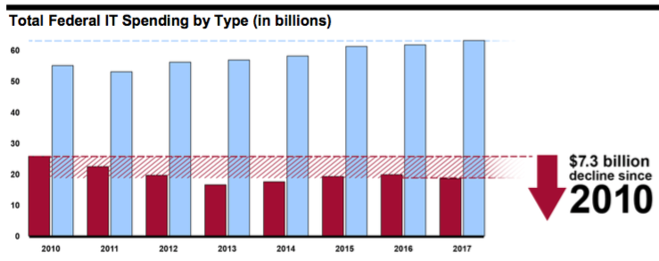
Maintenance vs. Development: Federal IT spending, 2010-2017
Development, modernization, enhancement
Operations & maintenance
Source: Government Accountability Office (GAO) report GAO-16-696T, Federal Agencies Need to Address Aging Legacy Systems, Testimony Before the Committee on Oversight and Government Reform, House of Representatives. Published May 26, 2016.

Slide 52
Legacy SW vs. Beautiful SW
Legacy code: old SW that continues to meet customers' needs, but difficult to evolve due to design inelegance or antiquated technology
60% SW maintenance costs adding new functionality to legacy SW
17% for fixing bugs
Vital but ignored topic in most SWE courses
Contrasts with beautiful code: meets customers' needs and easy to evolve
Notes:
60% SW maintenance
17% fixing bugs
Failure: Unexpectedly short-lived code
Yet Legacy SW is successful SW

Slide 53
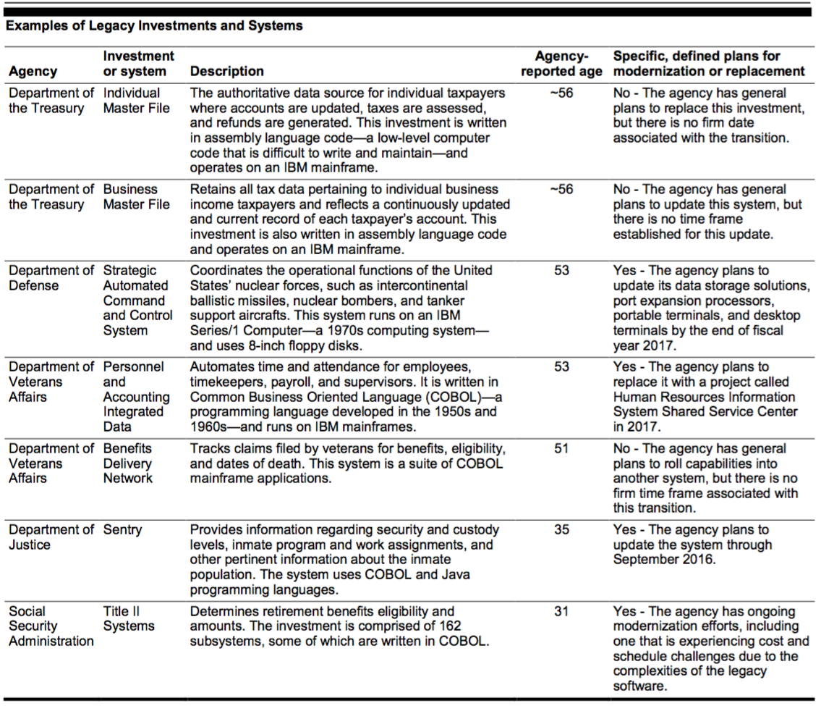
Your Tax Dollars at Work
Source: Government Accountability Office (GAO) report GAO-16-696T
Notes:
Replacing existing applications is MUCH harder than you think!

Slide 54
Software Quality
Product quality (in general): "fitness for use"
Business value for customer and manufacturer
Quality Assurance :
processes/standards => high quality products
improve quality
Software quality:
Satisfies customers' needs—easy to use, gets correct answers, does not crash, …
Be easy for developer to debug and enhance
Software QA: ensure quality and improve processes in SW organization

Slide 55
Assurance
Verification: Did you build the thing right?
Did you meet the specification?
Validation: Did you build the right thing?
Is this what the customer wants?
Is the specification correct?
Hardware focus generally Verification
Software focus generally Validation
Testing to Assure Software Quality
Notes:
HW on verification
SW on validation

Slide 56
Exhaustive testing is infeasible
Divide and conquer: perform different tests at different phases of SW development
Upper level doesn't redo tests of lower level
Coverage: various measurements of what % of system is "exercised" by test suite
Unit test: single method does what was expected
Module or functional test: across individual units
Integration test: interfaces between units have consistent assumptions, communicate correctly
System or acceptance test: integrated program meets its specifications

Slide 57
Which statement is NOT true about testing?
Tests that have outlived their usefulness should be discarded
While difficult to achieve, 100% test coverage ensures correct implementation
Higher level tests typically delegate more detailed testing to lower levels
Unit testing works within a single class and module testing works across classes

Slide 58
And in Conclusion: §§1.1-1.7
SaaS less hassle for developers and users
Service Oriented Architecture makes it easy to reuse current code to create new apps
Scale led to savings/CPU => reduced cost of Cloud Computing => Utility Computing
Testing to assure software quality, which means good for customer and developer
Developer Productivity: Conciseness, Synthesis, Reuse, and Tools

Slide 59
Productivity: Conciseness, Synthesis, Reuse, and Tools
Engineering Software as a Service §1.7
David Patterson

Slide 60
Productivity
50 years of Moore’s Law => 2X /1.5 years
HW designs get bigger
Faster processors and bigger memories
SW designs get bigger
Had to improve SW productivity
4 techniques
Clarity via conciseness
Synthesis
Reuse
Automation and Tools

Slide 61
Clarity via conciseness
Syntax: shorter and easier to read
assert_greater_than_or_equal_to(a,7) vs. a.should be ≥ 7
Time.now – 2*60*60 vs. 2.hours.ago
Raise the level of abstraction:
High level programming languages vs. assembly language
Automatic memory management (Java vs. C)
Reflection, metaprogramming
Notes:
a.should be ≥ 7

Slide 62
Leverage Existing vs. Write New Code
Procedures and functions
Standardized libraries (reuse single task)
Object oriented programming: reuse and manage collections of tasks
Design patterns: reuse a general strategy even if implementation varies

Slide 63
Synthesis: Code that writes code
Commonly used today: templating and code generators (many examples in Rails)
Research Stage: Programming by example
e.g. Excel 2013 Flash Fill

Slide 64
Automation and Tools
Replace tedious manual tasks with automation to save time, improve accuracy
New tool can make lives better (e.g., make)
New tool desiderata: learning curve justifies productivity gained
Good software developer must repeatedly learn how to use new tools: lifetime learning
Lots of chances in this course:Cucumber, RSpec, Pivotal Tracker, …

Slide 65
DRY
"Every piece of knowledge must have a single, unambiguous, authoritative representation within a system."
Andy Hunt and Dave Thomas, 1999
Don't Repeat Yourself (DRY)
vs. apply same repair in many places manually
How: Refactor code to extract commonality

Slide 66
Agile proponents claim that Agile can result in higher productivity because
Test-driven development results in more thorough tests and bugs being found faster
Less time is spent in project meetings because Agile is a more lightweight process
The tools used in Agile tend to operate at a higher level of abstraction than P&D's tools
Constant customer feedback means less time is potentially lost implementing features customer didn't want

Slide 67
Eric’s Rule of Beautiful & Legacy Code
Verified (Tested) + Validated (Production) = Beautiful X 2
**Successfully rewriting code and applications is ALWAYS much more difficult than you assume!**
Alternative:
Utilizes Service-Oriented (and Component) Architectures to gradually refactor Legacy Code away from the User Experience (GUI) while maintaining the code business logic. Then replace the remaining business logic gradually and as-needed.

